Slide 1

Introduction to Multimedia
AUTHORING TOOLS

Slide 2


Objectives
How multimedia products are created and authored.
What kinds of multimedia authoring tools you have to choose from to suit your project needs.
How various multimedia authoring tools work.

Slide 3


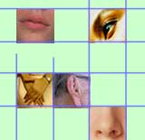
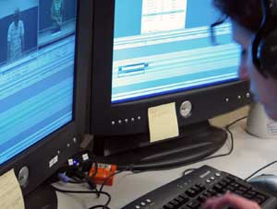

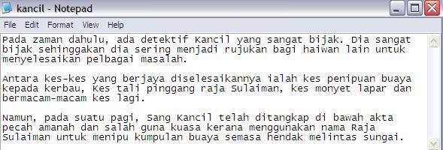
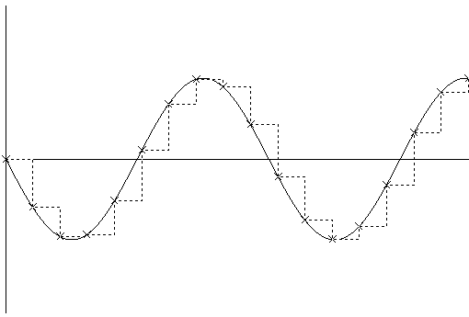
What is an Authoring Tools
The tools by which various media components are brought together (integrated) into a structure and flow.

Slide 4
Authoring Metaphors
Most media integration tools will take or use one of the following metaphors:
  Movie screen metaphor
  Slide show metaphor
  Linked screens

Slide 5
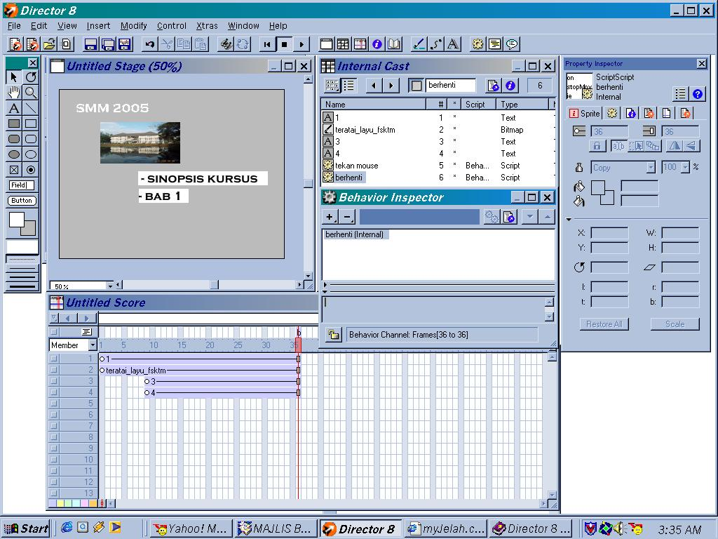
Authoring Metaphors
  Movie screen metaphor
    Movie refers to the product of the authoring:
      Linear/Interactive movie
    Also refers to authoring tools paradigm that contains Cast/Score/Scripting
    Example: Macromedia Director
Cast
Stage
Score

Slide 6
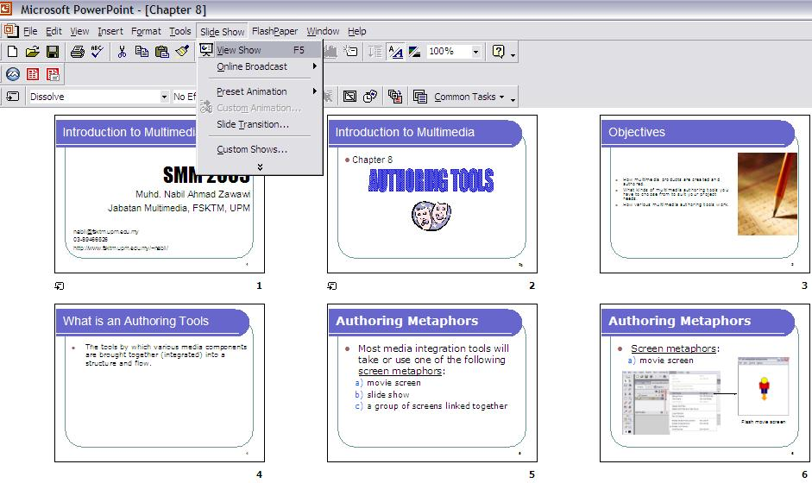
Authoring Metaphors
  Slide show metaphor
    A linear presentation
    Example: Powerpoint

Slide 7
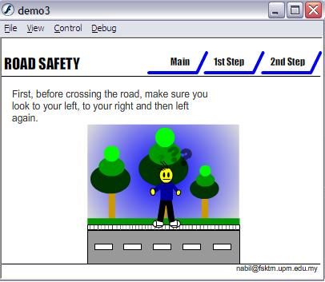
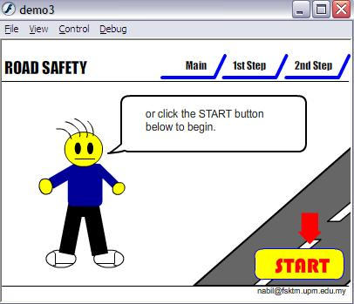
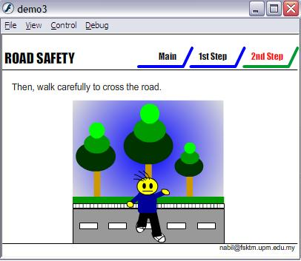
Authoring Metaphors
Linked Screens
  A group of scene linked together

Slide 8
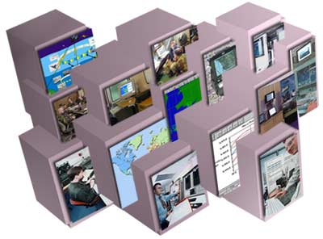
Features of Authoring Tools
Most Authoring tool have the following features in their development interface:
  A list of media events
  Iconic flowchart / timeline
  Card stack
  A series of figures

Slide 9
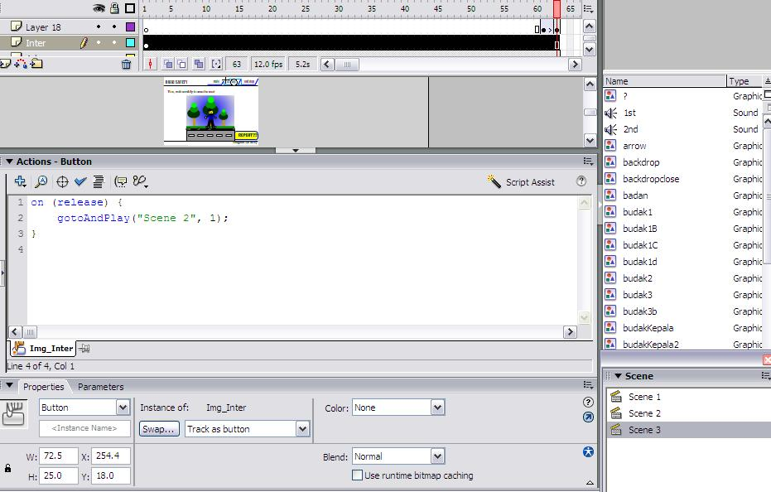
Features of Authoring Tools
A list of media events
  Occurrences of scene, images, sound,action in the end product.

Slide 10
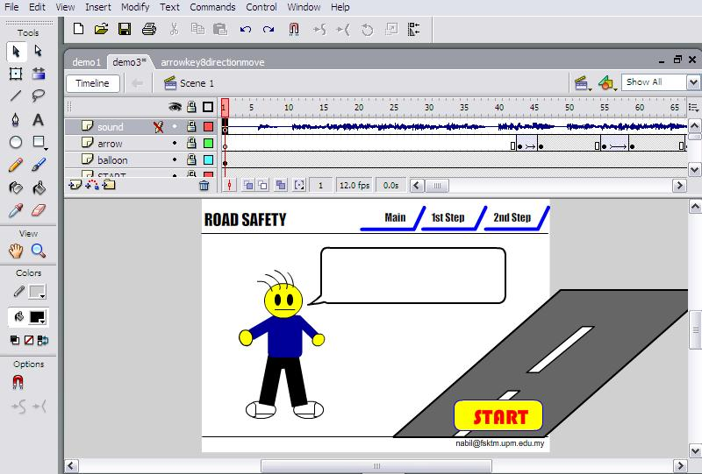
Features of Authoring Tools
Iconic flowchart / timeline
  Controls event sequence.

Slide 11
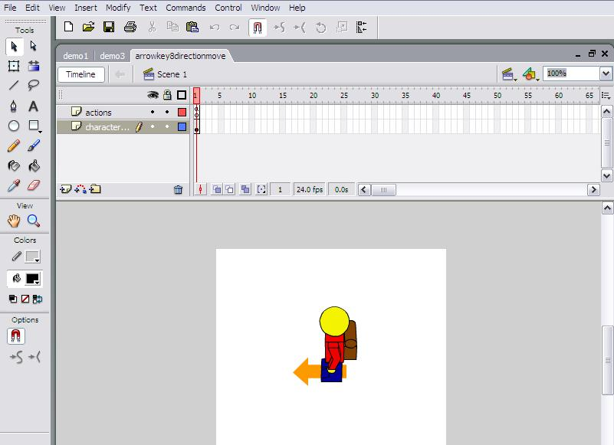
Features of Authoring Tools
Card stack (tabs)
  Easy viewing if there is too many item on screen.
Card stack

Slide 12
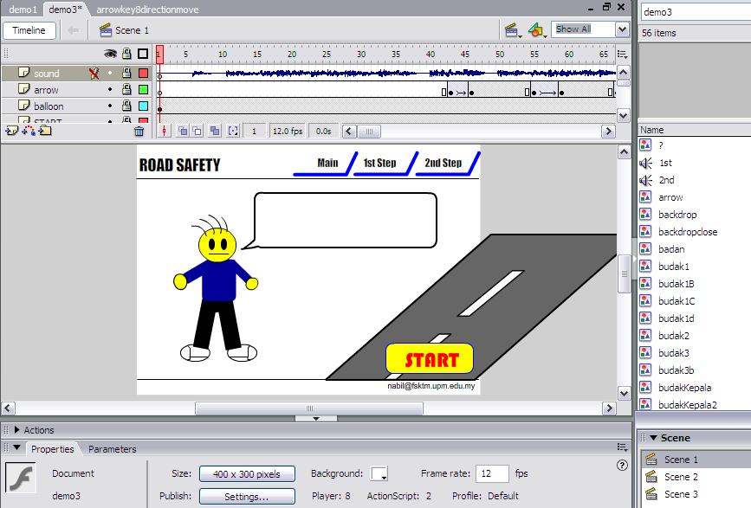
Features of Authoring Tools
A series of figures
  List of images / objects in the project
  Information about objects
figures

Slide 13
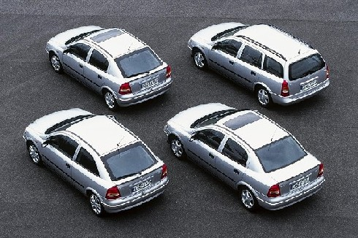
Categories of Authoring Tools
Can be categorized into
    Presentation software
    Tools for creating production
    Interactive training and education
Some authoring tools can fit into more than one category.

Slide 14

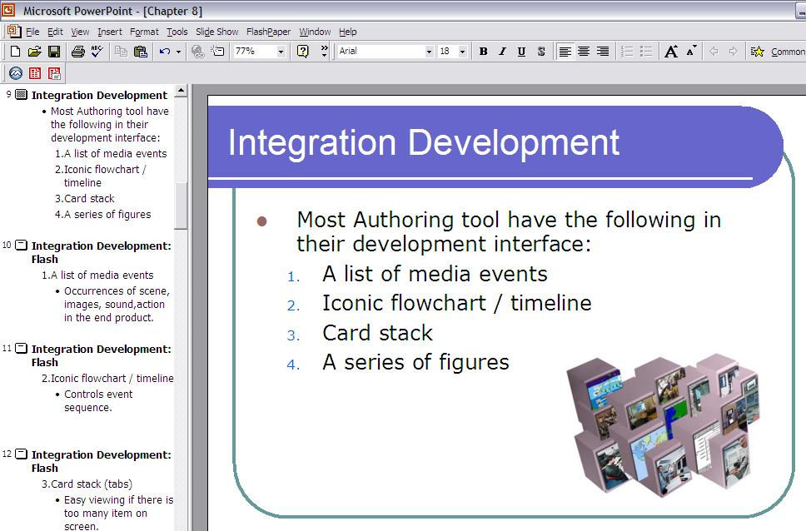
1. Presentation software
Enable users to create and deliver business presentations in the form of the slide show.
Each major heading is the beginning of a new slide.
heading

Slide 15
1. Presentation software
Templates are used to determine how the heads and subheads are formatted and displayed over backgrounds, including: (etc PowerPoint)
  position
  size
  font
  style
  color

Slide 16
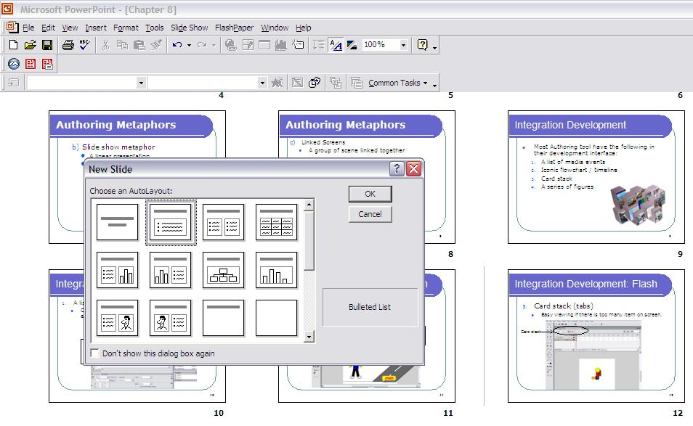
Example: PowerPoint Interface
Style and format
templates

Slide 17
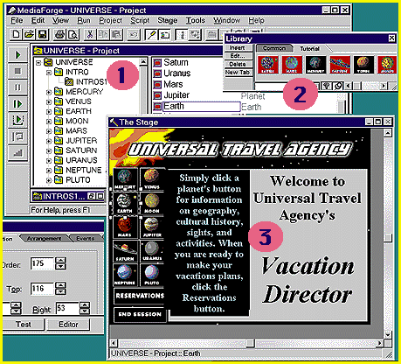
2. Tools for creating production
Usually integrate all types of' multimedia data into a multitrack timeline that determines the evolution of events
Interactivity takes the form of conditional branching (multiple linking) that can make navigation decisions based on user input and other conditions
Production software creates dynamic content
  EXAMPLE: mTropolis / AppleMedia Tool / MediaForge

Slide 18

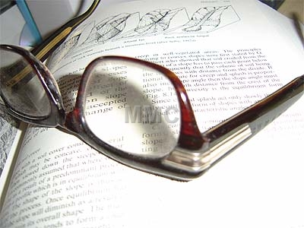
3. Interactive training and education tools
To create education or training content.
Designed primarily to present information in an Interactive book.
Multimedia-oriented programming languages such as Visual Basic represent another authoring alternative.
Offers the higher flexibility, performance speed and power
Example: Macromedia Flash, Authorware & Director

Slide 19
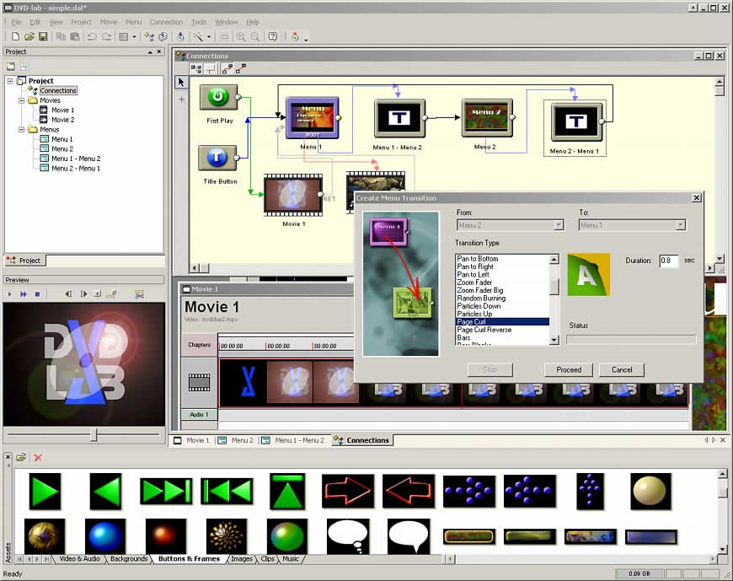
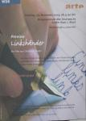
Types of Authoring Tools
Card or page based
Icon based
Time based
Object based

Slide 20
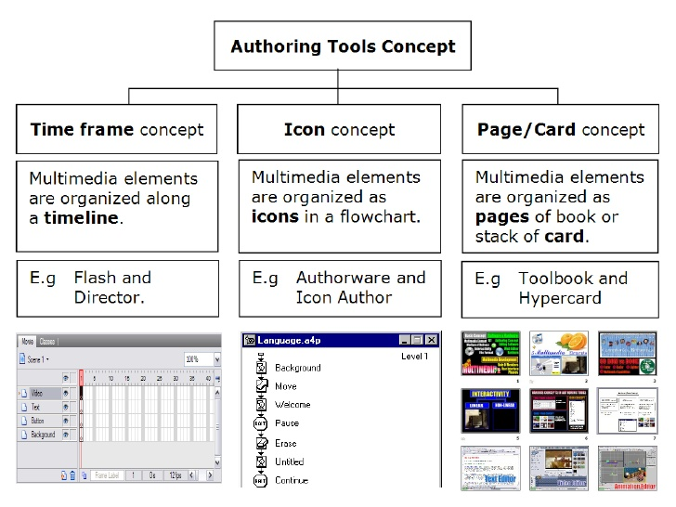
Authoring Tools Concept

Slide 21
1. Card Based
Cards are developed that have different elements associated with them.
Cards are put in stack.
Cards or pages combine to make up a book.
  example of authoring tools
    HyperCard (Mac)
    ToolBook (Mac / Windows)

Slide 22
Card Based
The elements are organized as pages of a book or a stack of cards.
Card-or page-based authoring systems
best used when the bulk of your content consists of elements that can be viewed individually
the pages of a book or cards in a card file.
link these pages or cards into organized sequences.
jump, on command, to any page
play sound elements and launch animations and digital video.

Slide 23
Card Based
Advantages
Easy to understand
1 screen = 1 card = 1 page
Easy to use
-> Provide template
-> Short development time
Disadvantages
Some run only on one platform
Tools not more powerful

Slide 24
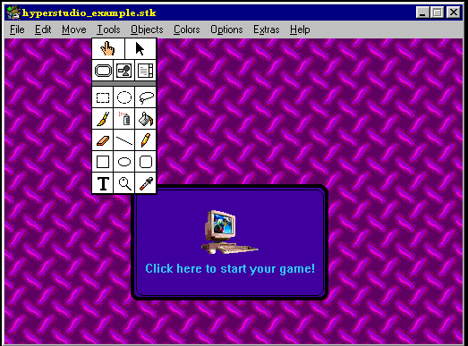
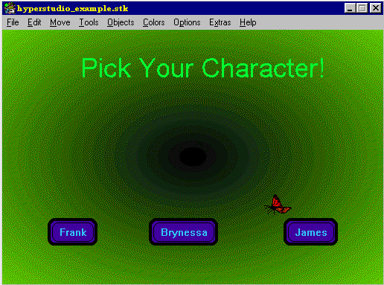
Card or page based tools

Slide 25
2. Icon Based
Icons are gathered along the line.
Provide visual development.
Flow chart is created to show the organisation of icons or elements:
  including activity list, results and done with dragging the icon/elements along the lines
  each Icon represents a particular event – button, graphics, text, video
  examples of authoring tools
    Authorware(Mac/Windows)
    IconAuthor (Windows)

Slide 26
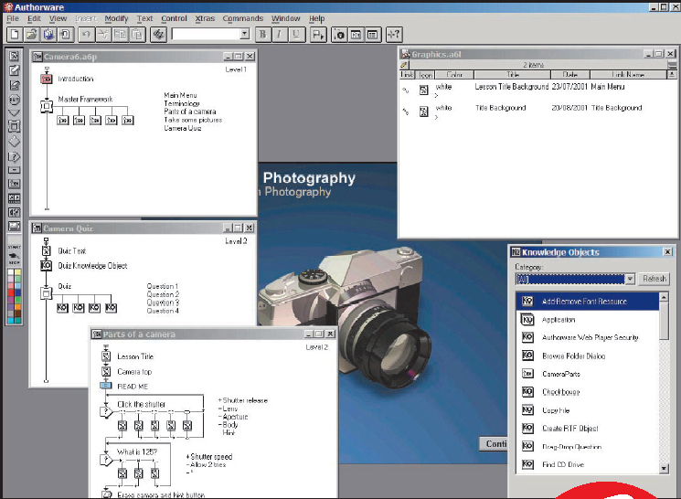

Icon Based

Slide 27
Icon Based
Advantages
Clear structure
Easy editing and updating

Slide 28
3. Time Based
The most popular used.
Using “timeline” for organizing activities
Also using “framing” – timely adjusted depending on the frame size
Example:- Macromedia Director / Flash (Mac/Windows)

Slide 29
3. Time Based
In these authoring systems, elements and events are organized along a timeline.
Time based tools are best to use when you have a message with a beginning and an end.

Slide 30
3. Time Based
Sequentially organized graphic frames are played back at a speed that you can set.
Other elements are triggered back at a given time or location in the sequence of events. The more powerful time based tools let your program jumps to any location in a sequence, thereby adding navigation

Slide 31
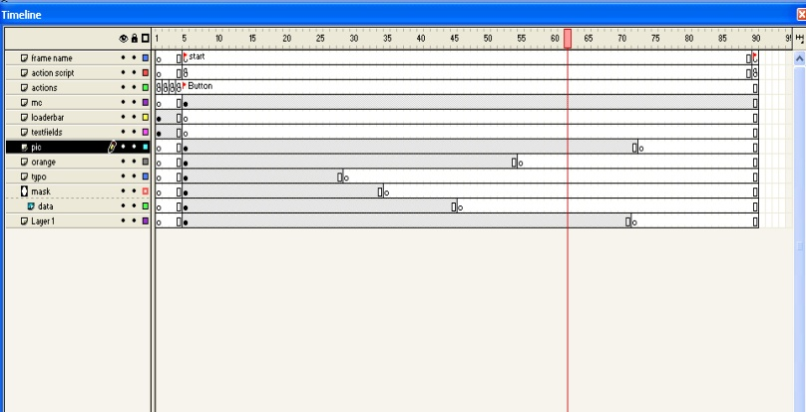
3. Time Based
Macromedia Director
Macromedia Flash

Slide 32
Time Based
Advantages
Good for creating animation
Branching, user control
Disadvantages
Expensive
Steep learning curve for advanced features

Slide 33
Time Based
Macromedia Flash
-> Flash is used for delivering rich multimedia content to the web
-> It allows the creation of simple static HTML pages with the flash player plug-in

Slide 34
4. Object Based
Support environment based on object.
Every object is modified using properties & modifiers
The environment is based on ‘Hierarchy’ (section and sub-section).
Examples of the tools :
  mTropolis (Mac/Windows)
  AppleMedia Tool (Mac/Windows)
  MediaForge (Windows)

Slide 35
4. Object Based
Fig : MediaForge

Slide 36
Authoring Capabilities
Authoring tools should possess the following capabilities:
  Interactivity
  Playback
  Distribution/Delivery
  Editing
  Project Organization
  Programming / Scripting
  Cross Platform
  Internet Playability

Slide 37

Authoring Capabilities
Interactivity
  Simple Branching
    Ability to jump to any part of the product
    Eg:- by mouse click, keyboard input
  Conditional Branching
    Ability to jump to any part of products if agreed to certain
    condition (statement IF-THEN)
  Structured Language
    complex programming to enable the interactivity and navigation

Slide 38
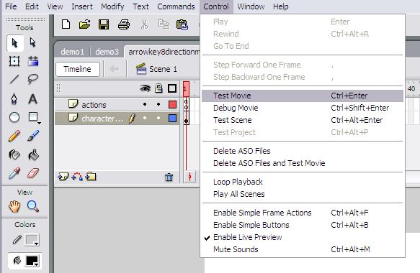
Authoring Capabilities
Playback
  Ability to see and to test the ongoing or the completed project.
Playback (timeline / movie tester)

Slide 39
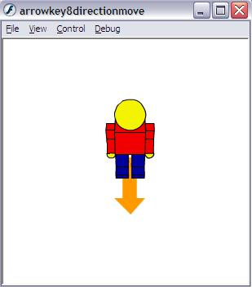
Distribution / Delivery
Able to create a ‘RUN TIME’ mode.
This will exclude the need of the authoring tools during execution.
Distribution / Delivery

Slide 40
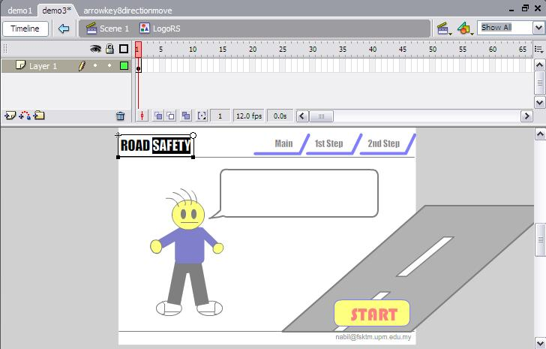
Authoring Capabilities
Editing
  generally, authoring tools are capable on text and image editing
  capable on doing other editing too, depending on the software used
Editing

Slide 41
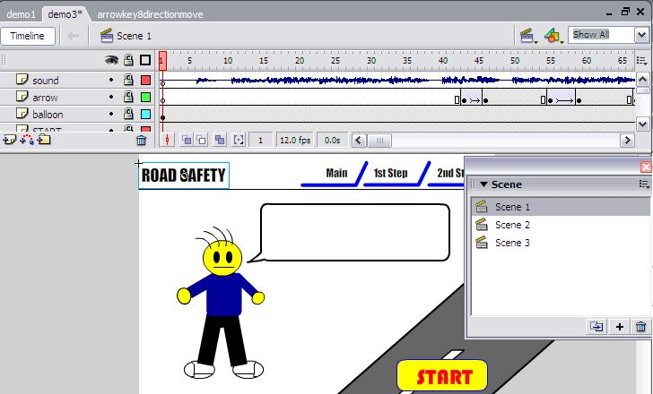
Authoring Capabilities
5. Project Organization
        FLOWCHARTING and STORYBOARDING availability
        this will help on configuring interactivity
Flowcharting / Storyboarding

Slide 42
Authoring Capabilities
Programming
  Programming used for flexibility.
  Authoring tools offers an easier and less time consuming to develop:-
    Visual Programming - Using icon, button, drag & drop graphic, audio .
      Eg: Authorware
    Scripting - programming language for authoring tools.
      Eg: Director = LINGO, Flash = ActionScript
    Support basic programming language - C, BASIC
      to make it more flexible
    Document Development Tools
      Authoring tools that able to merge documents, indexing, search engine and linking

Slide 43
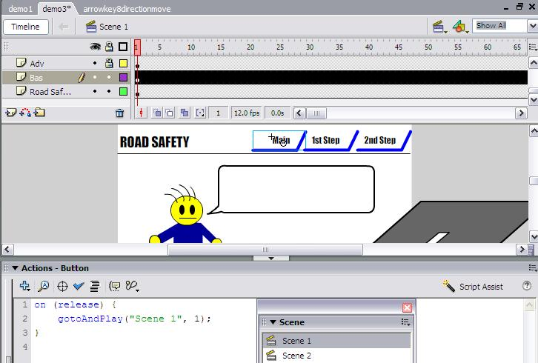
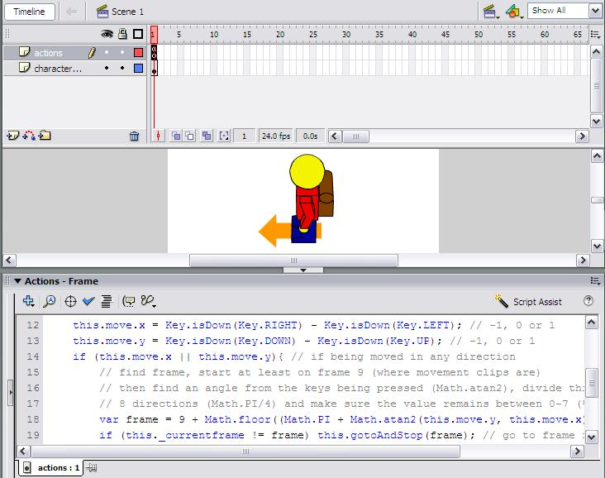
Programming

Slide 44
Authoring Capabilities
Html code:
<html>
<body>
The content of the body element is displayed in your browser.
</body>
</html>
Result:
The content of the body element is displayed in your browser.

Slide 45
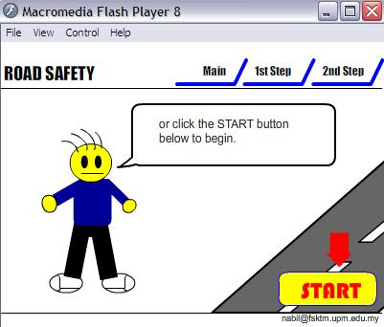
Authoring Capabilities
Cross Platform
  Ability to perform on all platforms including MAC and Windows.
Cross Platform

Slide 46
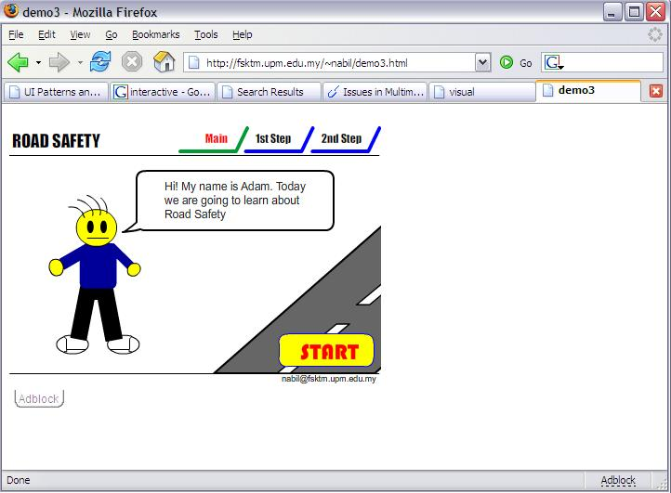
8. Internet Playability
  Ability to create the output for web enabled application.
  Eg:- HTML
Internet Playability

